Slide 1
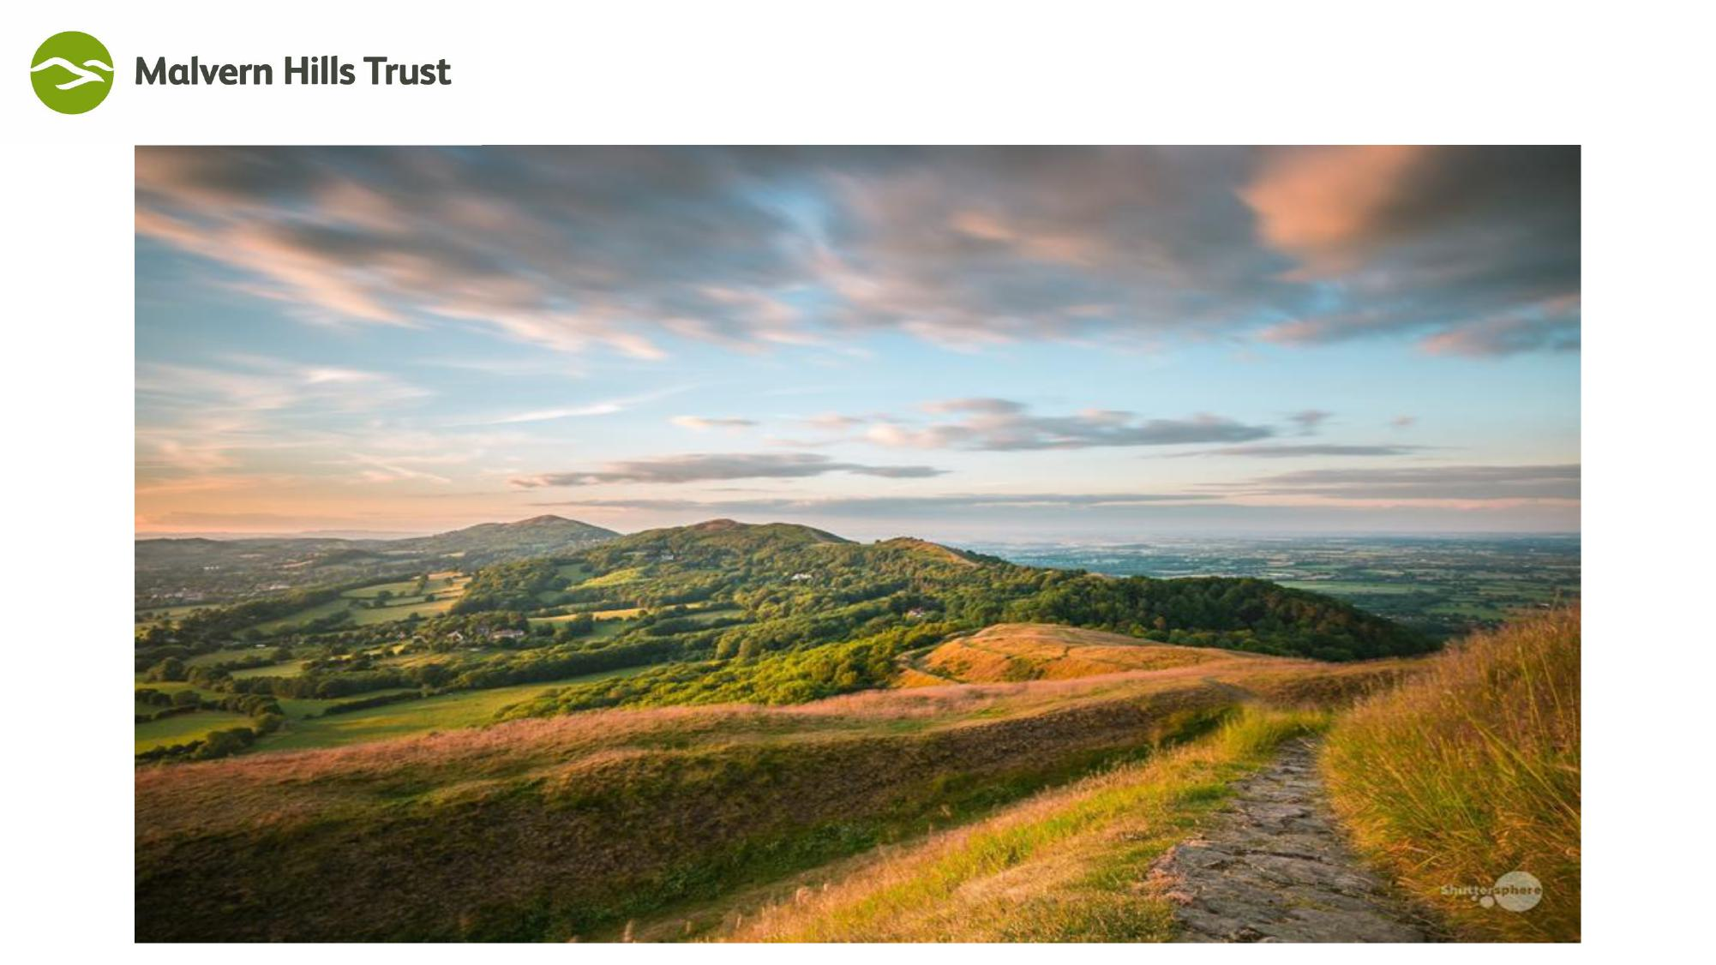
Caring for Malvern’s Hills and Commons
Charity no. 515804
Malvern Hills Bill
Evidence Slides of Susan Satchell

Slide 2

Caring for Malvern’s Hills and Commons
Charity no. 515804
INTRODUCTION

Slide 3
Caring for Malvern’s Hills and Commons
Charity no. 515804
Total number of trustees (elected and appointed) by electoral area
Parish/Ward | Number trustees
Guarlford | 1
Mathon | 2 (one appointed one elected)
Colwall | 3 (two elected one appointed)
Wells Ward | 1
Priory Ward | 1
West Ward | 1
Dyson Perrins Wars | 1
Pickersleigh ward | 1
Link Ward | 1
Chase ward | 1

Slide 4
Caring for Malvern’s Hills and Commons
Charity no. 515804
Appointed trustees by local government bodies (and Church Commissioners)
Malvern Hills District Council | 8 (who must be councillors)
Worcestershire County Council | 2
Worcestershire County Council under agreement dated 22.07.1968. These have always been trustees nominated by the parishes of Castlemorton, Newland and Powick | 3
Herefordshire Council | 2
Church Commissioners (no longer appoint) | 1

Slide 5
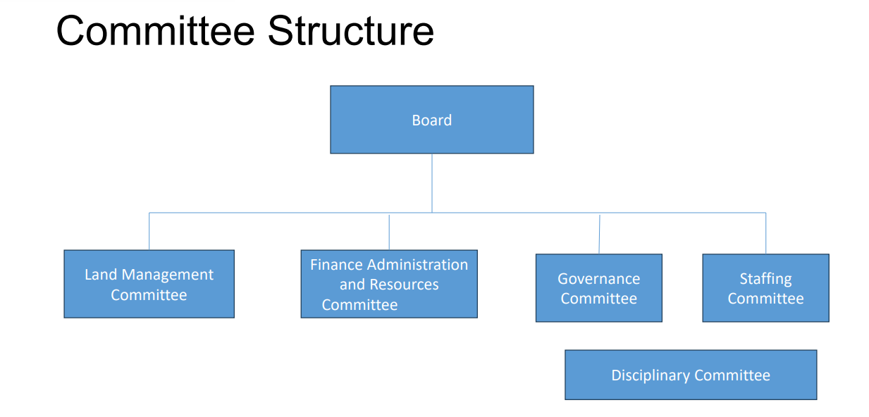
Caring for Malvern’s Hills and Commons
Charity no. 515804

Slide 6
Caring for Malvern’s Hills and Commons
Charity no. 515804
BOARD
Secretary to the Board p/t (
Alison Marlow
CEO
Deborah Fox
Land & Property Manager
Sarah Jordan
Finance and Admin Manager (p/t)
Nicky Gutteridge
Conservation Manager
Jonathan Bills
Governance Change Officer (p/t)
Susan Satchell
Operations Manager
Martin Barnett
Rangers
Richard Vale
Simon Roberts
Angela Norton
Mike Price
Timothy Booker
Gate Monitor
Richard Vale
Estate Supervisor
VACANT
Finance Officer
Lisa Curtis
Admin Assistants
(p/t)
Cheryl Morris
Lea Gleeson
Community & Conservation Officer
Marie Dipple
Conservation Officer (p/t)
Andy Pearce
Field Staff
Neil Tilley
Katie McEvoy
Duncan Patterson
William Stevenson
Charlie Harland
Volunteer Surveyors
Conservation Volunteers
Volunteer Rangers

Slide 7
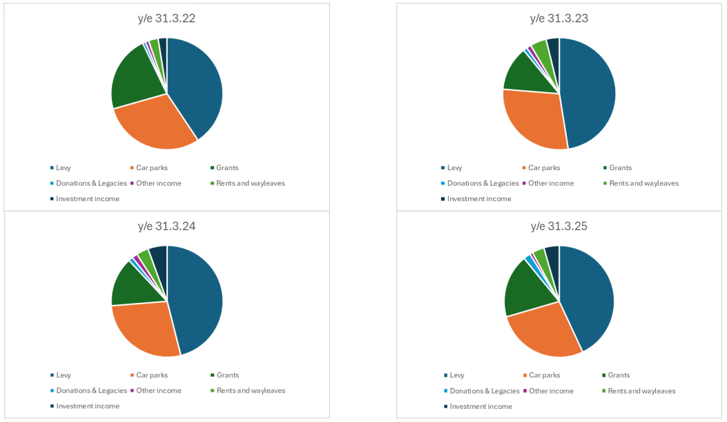
Caring for Malvern’s Hills and Commons
Charity no. 515804
Sources of Income

Slide 8
Caring for Malvern’s Hills and Commons
Charity no. 515804
Sources of income
 | y/e 31.3.22 |  | y/e 31.3.23 |  | y/e 31.3.24 |  | y/e 31.3.25
Levy | £ 566,950.00 | 40.6% | £ 595,300.00 | 46.8% | £ 663,800.00 | 46.1% | £ 697,070.00 | 42.6%
Car parks | £ 418,059.00 | 30.0% | £ 360,753.00 | 28.3% | £ 398,720.00 | 27.7% | £ 446,381.00 | 27.3%
Grants | £ 310,627.00 | 22.3% | £ 160,890.00 | 12.6% | £ 206,763.00 | 14.3% | £ 298,986.00 | 18.3%
Donations & Legacies | £ 11,939.00 | 0.9% | £ 13,879.00 | 1.1% | £ 18,243.00 | 1.3% | £ 33,926.00 | 2.1%
Other income | £ 13,581.00 | 1.0% | £ 16,529.00 | 1.3% | £ 22,913.00 | 1.6% | £ 13,895.00 | 0.8%
Rents, easements** and wayleaves | £ 38,815.00 | 2.8% | £ 78,407.00 | 6.2% | £ 50,931.00 | 3.5% | £ 73,688.00 | 4.5%
Investment income | £ 35,346.00 | 2.5% | £ 47,303.00 | 3.7% | £ 79,832.00 | 5.5% | £ 72,926.00 | 4.5%
 | £ 1,395,317.00 | 100.0% | £ 1,273,061.00 | 100.0% | £ 1,441,202.00 | 100.0% | £ 1,636,872.00 | 100.0%

Slide 9
Caring for Malvern’s Hills and Commons
Charity no. 515804
Management of Funds
General Fund
is the primary operating fund from which all day to day expenses are paid.
Designated Funds
These are part of the Trust’s unrestricted funds ( ie no restriction on how they can be spent)
They are sums set aside for specific purposes – eg the Trust set up an ash dieback and tree disease fund in 2021 because the anticipated spend to make safe diseased trees was £350,000 over 5 years.
These funds can be “undesignated” by Board resolution – there are no external limitations
Restricted Funds
There is a legal restriction on what these funds can be spent on. The bulk of the funds is invested on a long term basis through the Trust’s investment managers and pursuant to the Trust’s investment policies.
They include:
  Restricted grants and donations -
  Parliamentary Fund.
  Land Purchase (1992) Fund.
  Lands Maintenance Fund.

Slide 10
Caring for Malvern’s Hills and Commons
Charity no. 515804
Maximum chargeable under Levying Body (General) Regulations 1992, levy set by MHT and split between Malvern Hills District and Herefordshire Councils
Year | Maximum levy | Levy set | Levy Herefordshire Council | Levy Malvern Hills DC
 | £ | £ | £ | £
2018/19 | 585,558 | 499,250 | 47,250 | 452,000
2019/20 | 604,715 | 519,250 | 49,250 | 470,000
2020/21 | 619,402 | 534,850 | 50,750 | 484,100
2021/22 | 626,426 | 566,950 | 53,800 | 513,150
2022/23 | 656,864 | 595,300 | 56,500 | 538,800
2023/24 | 739,877 | 663,800 | 63,050 | 600,750
2024/25 | 805,436 | 697,070 | 66,270 | 630,800
2025/26 | 827,147 | 739,100 | 70,400 | 668,700

Slide 11
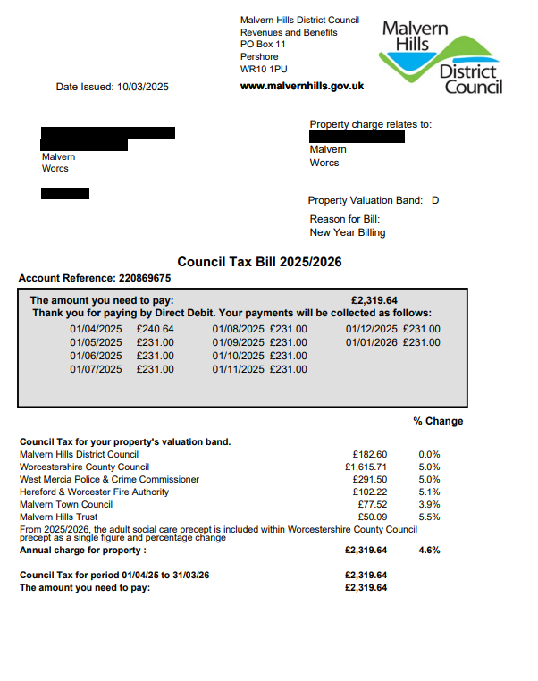
Caring for Malvern’s Hills and Commons
Charity no. 515804

Slide 12
Caring for Malvern’s Hills and Commons
Charity no. 515804
Management of Funds
General Fund
is the primary operating fund from which all day to day expenses are paid.
Designated Funds
These are part of the Trust’s unrestricted funds ( ie no restriction on how they can be spent)
They are sums set aside for specific purposes – eg the Trust set up an ash dieback and tree disease fund in 2021 because the anticipated spend to make safe diseased trees was £350,000 over 5 years.
These funds can be “undesignated” by Board resolution – there are no external limitations
Restricted Funds
There is a legal restriction on what these funds can be spent on. The bulk of the funds is invested on a long term basis through the Trust’s investment managers and pursuant to the Trust’s investment policies.
They include:
  Restricted grants and donations -
  Parliamentary Fund.
  Land Purchase (1992) Fund.
  Lands Maintenance Fund.

Slide 13
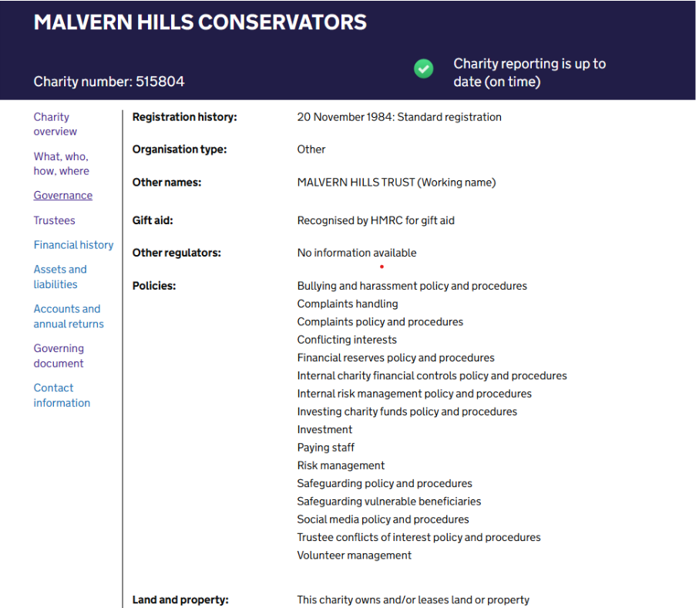
Caring for Malvern’s Hills and Commons
Charity no. 515804
Charity Commission Website
Governance Page

Slide 14
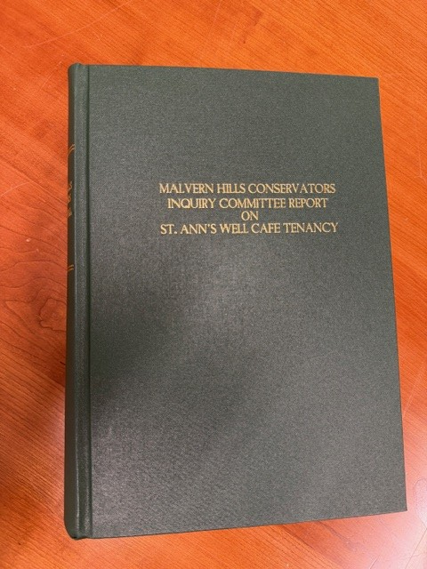
Caring for Malvern’s Hills and Commons
Charity no. 515804

Slide 15
Caring for Malvern’s Hills and Commons
Charity no. 515804
Effect of registration by Office for National Statistics
ONS wrote to the Trust on 5 June 2025:
“To clarify and allay your concerns, this formal classification has been undertaken purely for economic statistics purposes and should not impact on your organisation’s day to day activities.”
And their website says:
It is very important to note that decisions we take such as these are purely for the purpose of compiling economic statistics. Classification decisions do not affect the legal status or ownership of an entity.

Slide 16
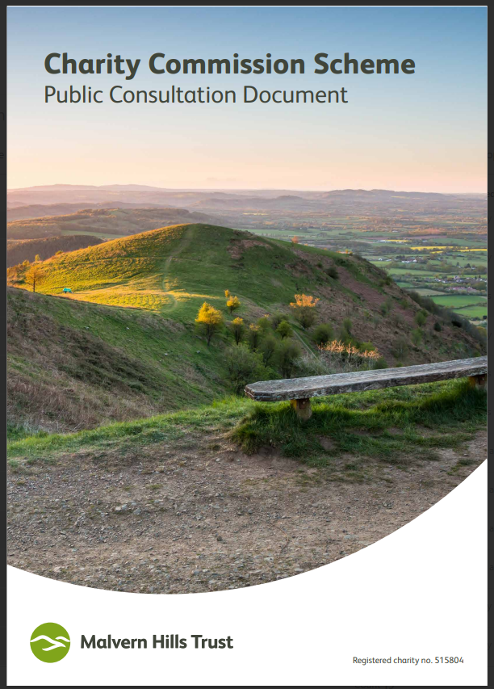
Caring for Malvern’s Hills and Commons
Charity no. 515804
MHT Charity Commission Scheme
2019 Public Consultation Document

Slide 17
Caring for Malvern’s Hills and Commons
Charity no. 515804
Public statement provided by Charity Commission 11 March 2020
“The Commission met with Malvern Hills Conservators (MHC) in late 2016 in relation to changes the charity were considering making to improve their governance arrangements and modernise the charity. These changes related to the five acts of parliament that govern the charity, which have been in operation since 1884.
At the time, and with the agreement of the Department for Digital, Media, Culture and Sport (DCMS) the Commission advised the charity to apply for a parliamentary scheme, to become effective via an Order by the Secretary of State for DCMS. MHC complied with this advice, preparing all relevant material for the scheme and, as advised, undertaking a public consultation, which took place between 2 September 2019 and 13 October 2019.
The amount of public interest the consultation generated was significant, particularly from precept payers of the charity, many of whom expressed concern about the proposed changes. It’s therefore been agreed by DCMS and the Commission, that these changes to the charity’s governing documents would now be best handled via a private bill, allowing greater scope for public scrutiny and debate than under a parliamentary scheme procedure. The charity has only recently been informed about the change in advice.
We understand this delay may be frustrating for people at the charity and others invested in the process, who want to see this issue resolved as quickly and as efficiently as possible. However, the significant amount of work undertaken by the charity in preparing for a parliamentary scheme will be relevant for preparing a private bill.
This charity manages a hugely significant and well-loved open space for the UK so it’s important to ensure that changes are made in the right way. The Commission and DCMS will therefore be supporting the charity as needed, as they pursue the next steps of this process.
Charity Commission for England and Wales
11 March 2020”

Slide 18
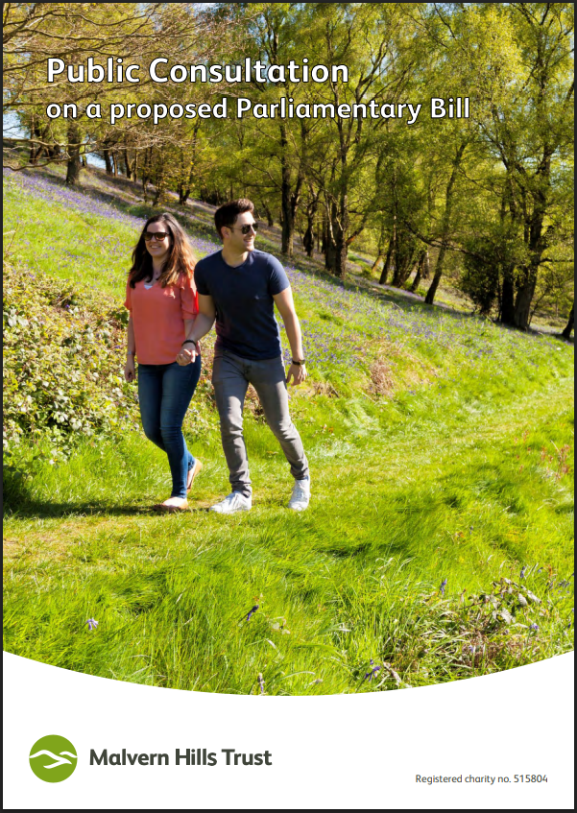
Caring for Malvern’s Hills and Commons
Charity no. 515804
Public consultation on a proposed Parliamentary Bill (2024)

Slide 19
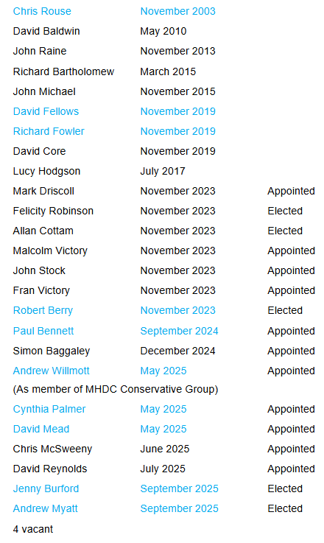
Caring for Malvern’s Hills and Commons
Charity no. 515804
Trustees – Date of Appointment
Blue text indicates Petitioner

Slide 20

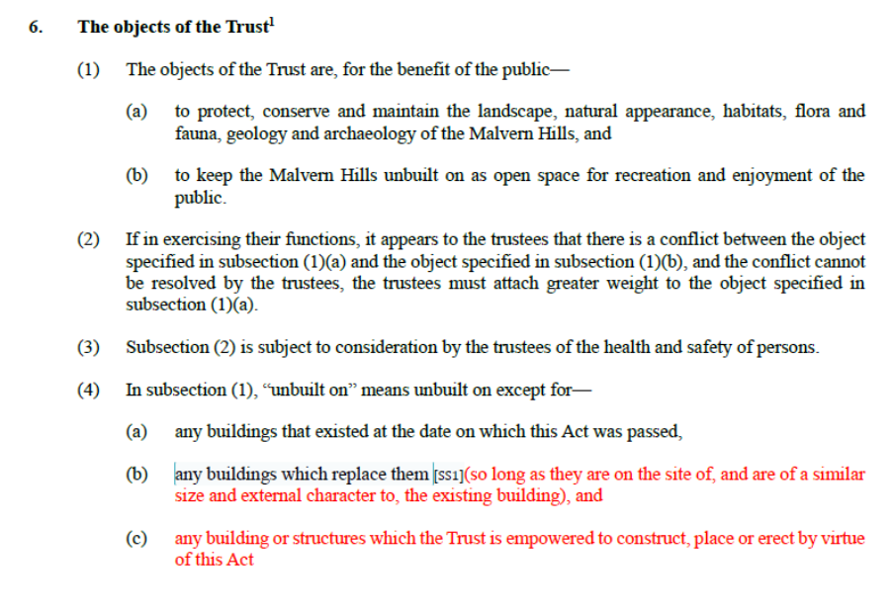
Caring for Malvern’s Hills and Commons
Charity no. 515804
Objects – Charity Commission Comment
MHT letter 25 October 2024

Slide 21
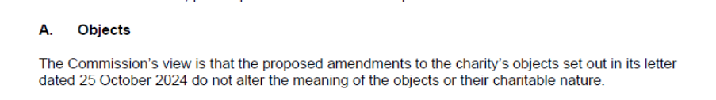
Caring for Malvern’s Hills and Commons
Charity no. 515804
Objects – Charity Commission Comment, Continued
Charity Commission letter 15 November 2024

Slide 22
Caring for Malvern’s Hills and Commons
Charity no. 515804
Parish/Ward | Number electors (end of 2025) | Number trustees | Electors per trustee
Guarlford | 207 | 1 | 207
Mathon | 241 | 2 (one appointed one elected) | 121
Colwall | 2036 | 3 (two elected one appointed) | 679
Wells Ward | 2463 | 1 | 2463
Priory Ward | 3243 | 1 | 3243
West Ward | 3196 | 1 | 3196
Dyson Perrins Ward | 3509 | 1 | 3509
Pickersleigh ward | 4461 | 1 | 4461
Link Ward | 4992 | 1 | 4992
Chase ward | 5117 | 1 | 5117
Appointment of trustees to the Board of Malvern Hills Trust
Total number of trustees (elected and appointed) by electoral area (showing voter numbers)

Slide 23
Caring for Malvern’s Hills and Commons
Charity no. 515804
Elections 2011 to present
2011 - 2014
 |  | 2011 |  |  |  | 2011 |  | 2014
 |  | Byelection Colwall (1 vacancy )& Mathon |  | Full Board – 27/10/2011? |  | Byelection Chase 1/12/11 |  | By election Mathon
 |  | 3 March 2011 |  |  |  |  |  | 3 July 2014
Ward/parish | No. of elected trustees | No information available | Turn out | Number candidates | Turn out | No candidates | Turn out | No information available
Chase | 1 |  |  | 0 |  | 3 | Unknown
Colwell | 2 |  |  | 4 | 20.4%
Dyson Perrins | 1 |  |  | 1 | uncontested
Guarlford | 1 |  |  | 2 | unknown
Link | 1 |  |  | 1 | uncontested
Mathon | 1 |  |  | 1 | uncontested
Priory | 1 |  |  | 2 | unknown
Pickersleigh | 1 |  |  | 1 | uncontested
West | 1 |  |  | 1 | uncontested
Wells | 1 |  |  | 1 | uncontested

Slide 24
Caring for Malvern’s Hills and Commons
Charity no. 515804
Elections 2011 to present
2015 - 2019
 |  | 2015 |  |  |  | 2019
 |  | By election Link |  | Full Board |  | Full Board
 |  | 26 March 2015 |  | 22 October 2015 |  | 1 November 2019
Ward/parish | No. of elected trustees | No. candidates | Turn out | No. candidates | Turn out
Chase | 1 |  |  | 1 | uncontested | 2 | 23%
Colwell | 2 |  |  | 2 | uncontested | 2 | uncontested
Dyson Perrins | 1 |  |  | 1 | uncontested | 2 | 10%
Guarlford | 1 |  |  | 1 | uncontested | 1 | uncontested
Link | 1 | 5 | 11.92% | 1 | uncontested | 1 | uncontested
Mathon | 1 |  |  | 2 | 33% | 1 | uncontested
Priory | 1 |  |  | 2 | 17% | 2 | 21.7%
Pickersleigh | 1 |  |  | 1 | uncontested | 1 | uncontested
West | 1 |  |  | 2 | 11% | 1 | uncontested
Wells | 1 |  |  | 1 | uncontested | 3 | 24.8%

Slide 25
Caring for Malvern’s Hills and Commons
Charity no. 515804
Elections 2011 to present
2021 - 2022
 |  | 2021 |  | 2022 |  | 2022
 |  | By election Priory |  | By election Chase |  | By election Chase
 |  | 6 May 2021 |  | 17 March 2022 |  | 5 May 2022
Ward/parish | No. of elected trustees | No. candidates | Turn out | No. candidates | Turn out | No. candidates | Turn out
Chase | 1 |  |  | 0 |  | 2 | 20.8%
Colwell | 2
Dyson Perrins | 1
Guarlford | 1
Link | 1
Mathon | 1
Priory | 1 | 3 | 41.4%
Pickersleigh | 1
West | 1 |  |  |  |  | 2
Wells | 1

Slide 26
Caring for Malvern’s Hills and Commons
Charity no. 515804
Elections 2011 to present
2023 - 2025
 |  | 2023 |  | 2023 |  | 2025
 |  | Full Board |  | By election Priory |  | By election Priory and W Malvern
 |  | 1 November 2023 |  | 7 December2023 |  | 18 September 2025
Ward/parish | No. of elected trustees | No. candidates | Turn out |  |  | No. candidates | Turn out
Chase | 1 | 2 | 21%
Colwell | 2 | 2 | uncontested
Dyson Perrins | 1 | 1 | uncontested
Guarlford | 1 | 1 | uncontested
Link | 1 | 1 | uncontested
Mathon | 1 | 1 | uncontested
Priory | 1 | 0 |  | 2 | 12% | 2 | 21%
Pickersleigh | 1 | 1 | uncontested
West | 1 | 1 | uncontested |  |  | 2 | 21%
Wells | 1 | 2 | 22%

Slide 27
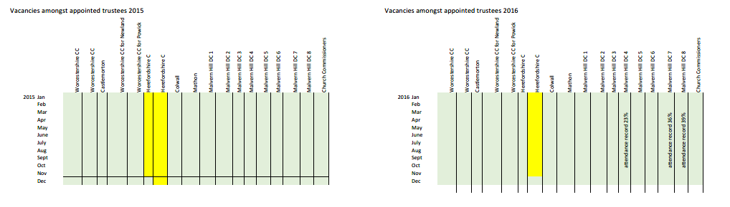
Caring for Malvern’s Hills and Commons
Charity no. 515804

Slide 28
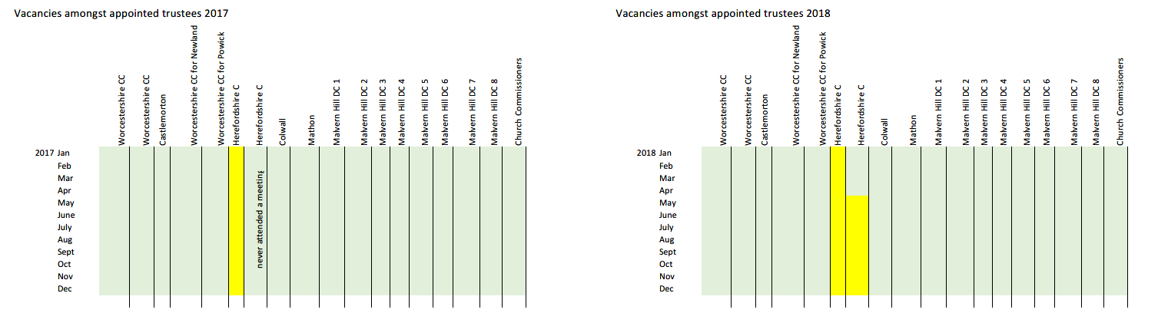
Caring for Malvern’s Hills and Commons
Charity no. 515804

Slide 29
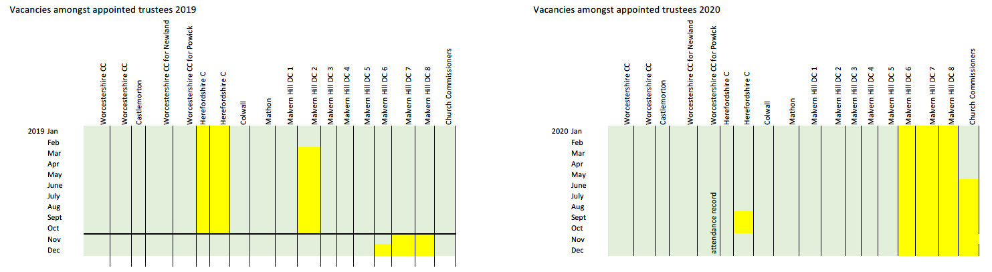
Caring for Malvern’s Hills and Commons
Charity no. 515804

Slide 30
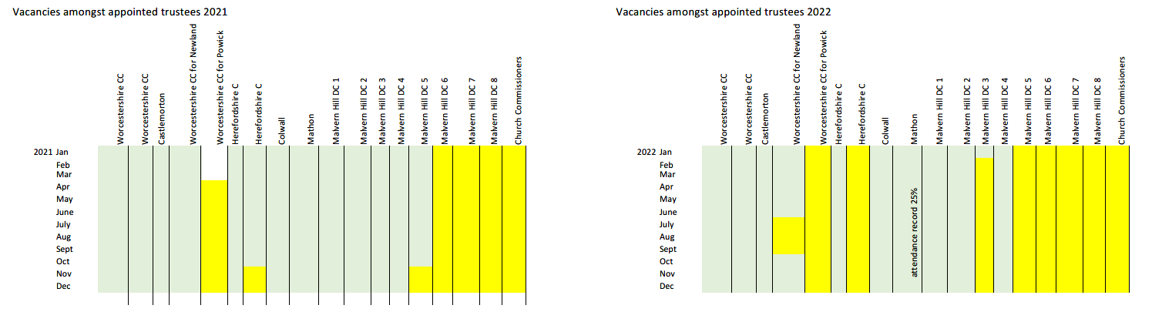
Caring for Malvern’s Hills and Commons
Charity no. 515804

Slide 31
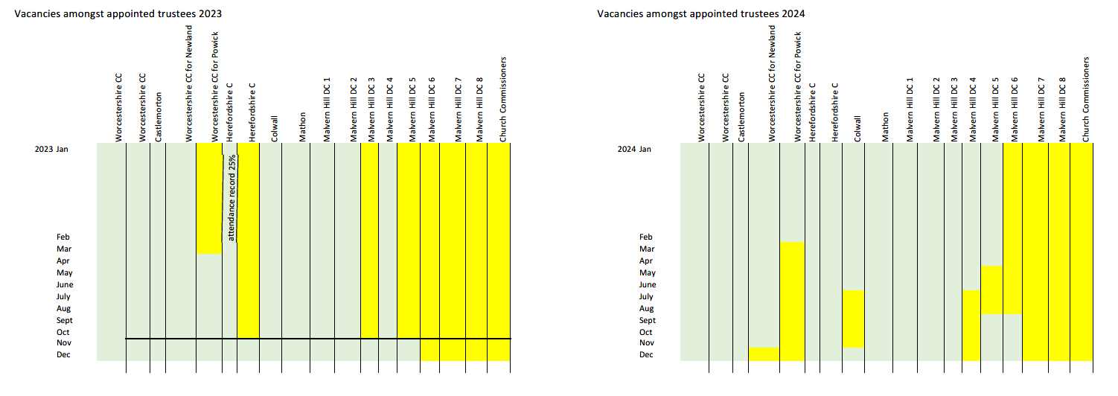
Caring for Malvern’s Hills and Commons
Charity no. 515804

Slide 32
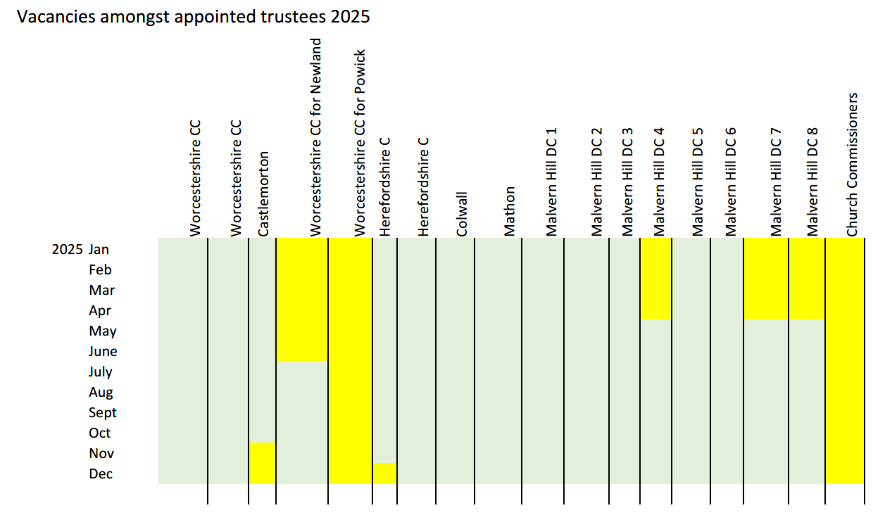
Caring for Malvern’s Hills and Commons
Charity no. 515804

Slide 33
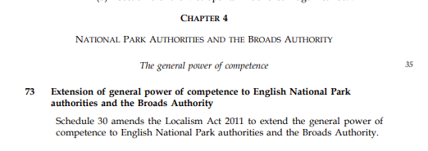
Caring for Malvern’s Hills and Commons
Charity no. 515804
Clause 73 of the English Devolution and Community Empowerment Bill

