Slide 1
Slides for evidence from Dorian Gerhold

Slide 2
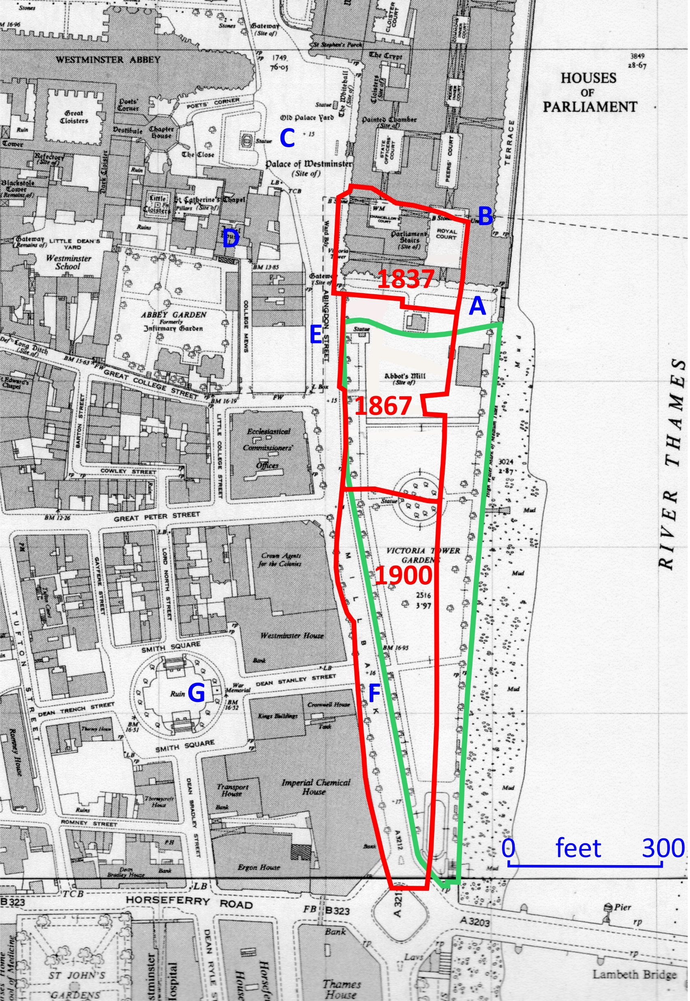
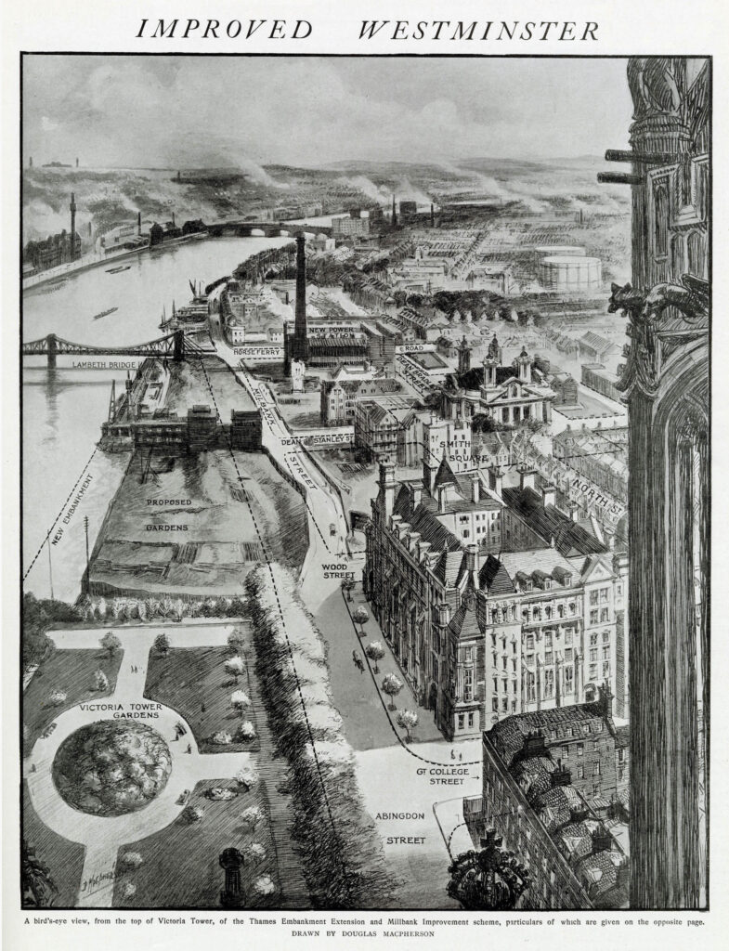

Slide 3
The Bill should provide, as part of the improvement, for a
continuation of the Ornamental Garden, called the Victoria
Tower Garden, as far south as Lambeth Bridge, over the space
between the new roadway of Millbank Street and the
Embankment. This public benefit, as in the first place proposed
to the First Commissioner, was one of the principal
considerations in his mind in favour of giving up a strip of the
existing garden, to maintain which as a public recreation
ground the Government are pledged by an agreement with the
late Rt. Hon. W.H. Smith M.P. who contributed a great part of
the cost of laying it out.”
“As regards the future maintenance of the garden, the First
Commissioner considers it essential, in order to ensure
uniformity in appearance and regulation between the present
garden and its continuation, that both should be under one
management… to be maintained by this Board as a garden for
public recreation”.
(First Commissioner of Works’ letter to LCC dated 23 February 1900;
underlining added). (Source: London Metropolitan Archives, LCC/CL/IMP/01/048)

Slide 4
Decision-making on the HMLC in 2015-16
2015
7 Sept Criteria for the site are published by the Foundation
26 Oct VTG suggested privately by Lord Feldman, for the Memorial only
c.16 Nov CBRE begins work assessing proposed sites
2016
11 Jan CBRE reports on 24 sites (not including VTG), shortlisting three
13 Jan UKHMF’s Board considers VTG for the first time, rejects all CBRE’s sites, and agrees in principle to siting a Memorial in VTG
27 Jan Prime Minister announces that the Memorial will be in VTG; does not mention the Learning Centre
13 July UKHMF’s Board recommends that the Learning Centre be constructed beneath the Memorial in VTG
14 Sept Launch of design competition

Slide 5
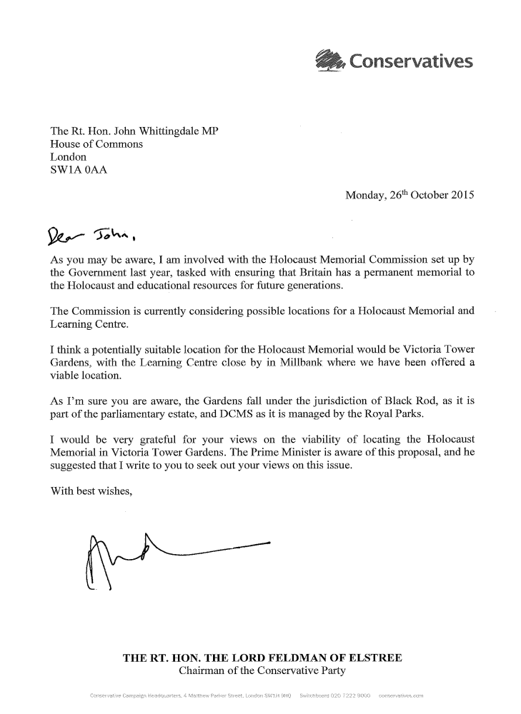
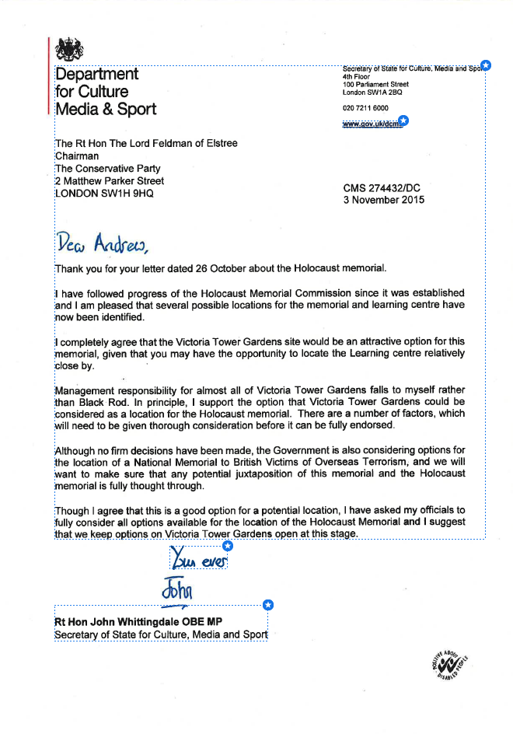

Slide 6
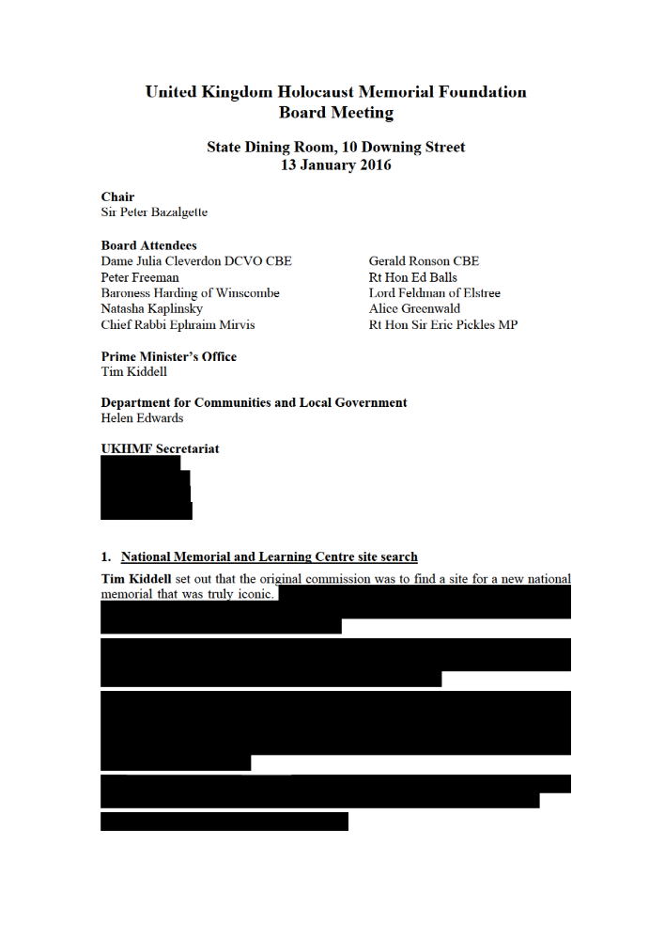


Part of the UKHMF minutes for 13 January 2016, as supplied in 2020

Slide 7
Written parliamentary answers about the HMLC, 2021 and 2019 (emphasis added)
Question: Sir Peter Bottomley: To ask the Secretary of State for Housing, Communities and Local Government, what the wording was of the recommendation of 13 January 2016 by the UK Holocaust Memorial Foundation relating to the location of the proposed Holocaust Memorial and Learning Centre; and if he will place the minutes of the relevant part of that meeting in the Library. (41613)
Answer, 13 Sept 2021: Luke Hall: The UK Holocaust Memorial Foundation recommendation of 13 January 2016 was “in principle to siting a memorial in the Gardens (without prejudice to the site of a learning centre )”.
Question: Sir Edward Leigh: To ask the Secretary of State for Housing, Communities and Local Government, pursuant to the Answer of 14 March 2019 to Question 229629 on National Holocaust Memorial Centre and Learning Service, whether the UK Holocaust Memorial Foundation’s recommendation in January 2016 was that both the Memorial and the Learning Centre should be in Victoria Tower Gardens. (239872)
Answer, 10 Apr 2019: Mrs Heather Wheeler: The Foundation’s advice has consistently been that the Memorial and Learning Centre should be co-located. Information obtained through the design competition allowed Ministers to conclude that co-location would be feasible and they announced on 24 October 2017 their decision to proceed with an integrated design.
Question: Sir Edward Leigh: To ask the Secretary of State for Housing, Communities and Local Government, pursuant to the Answers of 7 March 2019 to Question 229626 and 10 April 2019 to Question 239872, on what date in January 2016 the Government received from the UK Holocaust Memorial Foundation its recommendation that the Holocaust Memorial and the Holocaust Learning Centre should be located in Victoria Tower Gardens. (248582)
Answer, 08 May 2019: Mrs Heather Wheeler: 13 January 2016.

Slide 8
